Slide 1
Chapter 5: Project Scope Management
Information Technology Project Management, Ninth Edition
Note: See the text itself for full citations

Slide 2
Project Scope Management
The Project Scope Management details how the project scope will be defined, developed, and verified.
Project Scope Management refers to the set of processes that ensure a project's scope is defined and mapped accurately.
Notes:
What will the project produces at the end: ensure the project includes all the work required

Slide 3
Learning Objectives
Understand good project scope management
Describe the process of planning scope management
Discuss methods for collecting and documenting requirements to meet stakeholder needs and expectations
Explain the scope definition process and describe the contents of a project scope statement
Discuss the process for creating a work breakdown structure using the analogy, top-down, bottom-up, and mind-mapping approaches
Notes:
Key Points:

Slide 4
Learning Objectives
Explain the importance of validating scope and how it relates to defining and controlling scope
Understand the importance of controlling scope and approaches for preventing scope-related problems on information technology (IT) projects
Describe how software can assist in project scope management

Slide 5
What is Project Scope Management?
Scope refers to all the work involved in creating the products of the project and the processes used to create them
A deliverable is a product produced as part of a project, such as hardware or software, planning documents, or meeting minutes
Project scope management includes the processes involved in defining and controlling what is or is not included in a project

Slide 6
Project Scope Management Processes
Main processes
Planning scope management: determining how the project’s scope and requirements will be managed
Collecting requirements: defining and documenting the features and functions of the products produced during the project as well as the processes used for creating them
Defining scope: reviewing the project charter, requirements documents, and organizational process assets to create a scope statement
Creating the WBS: subdividing the major project deliverables into smaller, more manageable components
Validating scope: formalizing acceptance of the project deliverables
Controlling scope: controlling changes to project scope throughout the life of the project

Slide 7
Project Scope Management Processes
Planning scope: determining how the project’s scope and requirements will be managed
Collecting requirements: defining and documenting the features and functions of the products produced during the project as well as the processes used for creating them
Defining scope: reviewing the project charter, requirements documents, and organizational process assets to create a scope statement
Creating the WBS: subdividing the major project deliverables into smaller, more manageable components
Monitoring and Controlling
Validating scope: formalizing acceptance of the project deliverables
Controlling scope: controlling changes to project scope throughout the life of the project
Notes:
How to manage the scope! 5 Processes Collect Re-> Define scope-> Create WBS➔ verify S→ Control scope

Slide 8
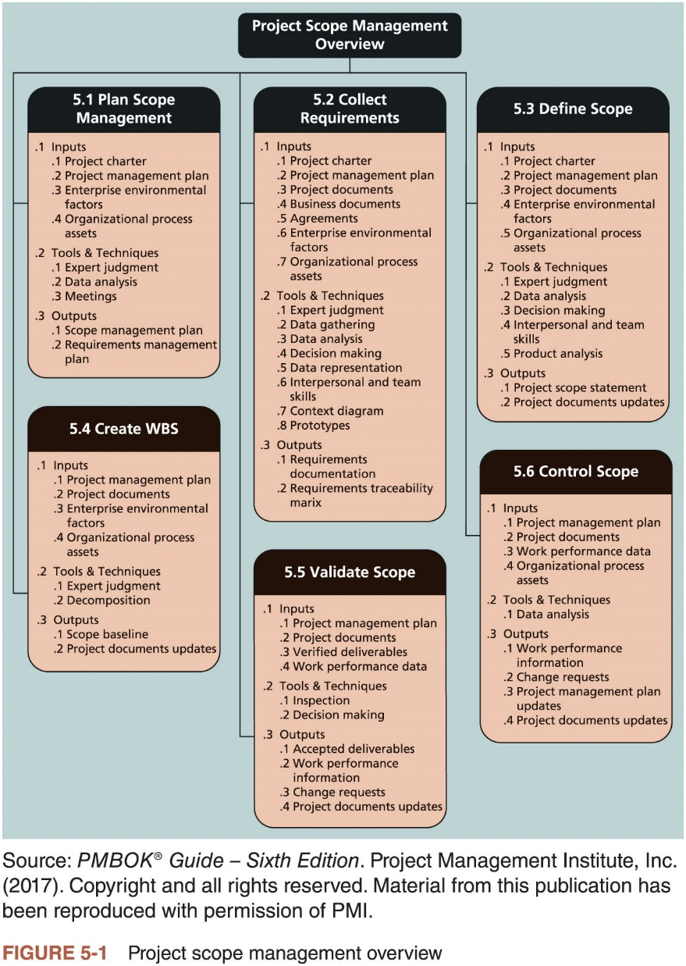
Project Scope Management Processes

Slide 9
Planning Scope Management
The project team uses expert judgment, data analysis, and meetings to develop two important outputs
Scope management plan (subsidiary part of the project management plan)
Requirements management plan
Scope management plan contents
Prepare a detailed project scope statement
Create a WBS
Maintain and approve the WBS
Obtain formal acceptance of the completed project deliverables
Control requests for changes to the project scope

Slide 10
Planning Scope Management
The requirements management plan documents how project requirements will be analyzed, documented, and managed
How to plan, track, and report requirements activities
How to perform configuration management activities
How to prioritize requirements
How to use product metrics
How to trace and capture attributes of requirements

Slide 11
Collecting Requirements
Several ways to collect requirements
Interviewing stakeholders
Holding focus groups and facilitated workshops
Using group creativity and decision-making techniques
Utilizing questionnaires and surveys
Conducting observation studies
Generating ideas by comparing specific project practices or product characteristics (i.e., benchmarking)

Slide 12
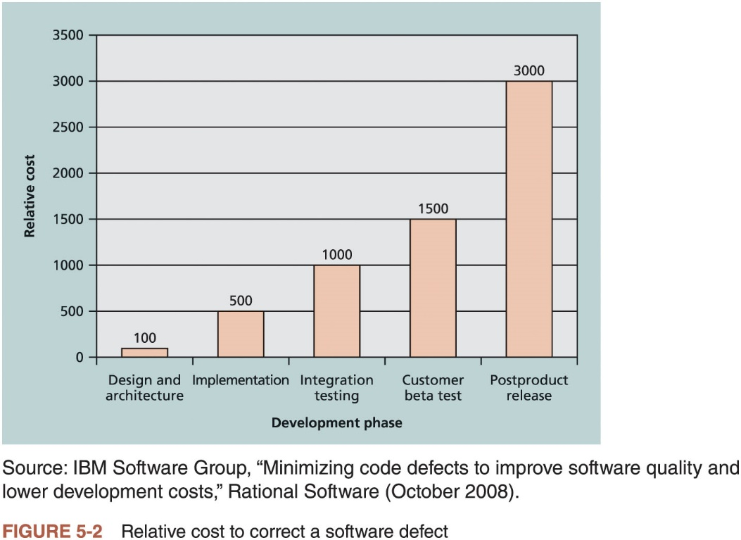
Collecting Requirements

Slide 13
Collecting Requirements
Requirements traceability matrix (RTM): a table that lists requirements, various attributes of each requirement, and the status of the requirements to ensure that all requirements are addressed
Requirement No. | Name | Category | Source | Status
R32 | Laptop memory | Hardware | Project charter and corporate laptop specifications | Complete. Laptops ordered meet memory requirement.
Table 5-1 Sample entry in a requirements traceability matrix

Slide 14
Defining Scope
Important elements of a project scope statement
Product scope description
Product user acceptance criteria
Detailed information on all project deliverables
It is also helpful to document other scope-related information
Project boundaries, constraints, and assumptions
Supporting document references (e.g., product specifications)
As time progresses, the scope of a project should become more clear and specific

Slide 15
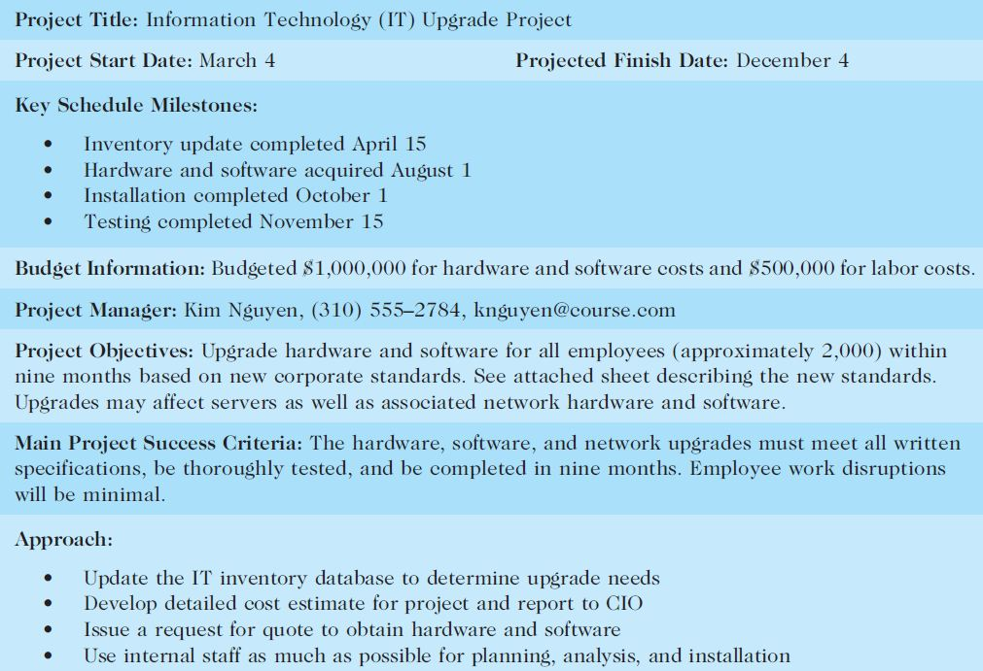
Sample Project Charter (partial)

Slide 16
Defining Scope (2 of 2)
Project Charter: Upgrades may affect servers . . . (listed under Project Objectives)
Project Scope Statement, Version 1: Servers: If additional servers are required to support this project, they must be compatible with existing servers. If it is more economical to enhance existing servers, a detailed description of enhancements must be submitted to the CIO for approval. See current server specifications provided in Attachment 6. The CEO must approve a detailed plan describing the servers and their location at least two weeks before installation.
Project Scope Statement, Version 2: Servers: This project will require purchasing 10 new servers to support Web, network, database, application, and printing functions. Virtualization will be used to maximize efficiency. Detailed descriptions of the servers are provided in a product brochure in Attachment 8, along with a plan describing where they will be located.
Table 5-3 Further defining project scope

Slide 17
Creating the Work Breakdown Structure (1 of 9)
Work Breakdown Structure (WBS) is a deliverable-oriented grouping of the work involved in a project that defines the total scope of the project
Foundation document that provides the basis for planning and managing project schedules, costs, resources, and changes
Decomposition is the main tool or technique for creating a WBS
Subdividing project deliverables into smaller pieces
A work package is a task at the lowest level of the WBS
Outputs of creating the WBS are the scope baseline and project documents updates
Scope baseline includes the approved project scope statement and its associated WBS and WBS dictionary
A work package is a task at the lowest level of the WBS
The scope baseline includes the approved project scope statement and its associated WBS and WBS dictionary

Slide 18
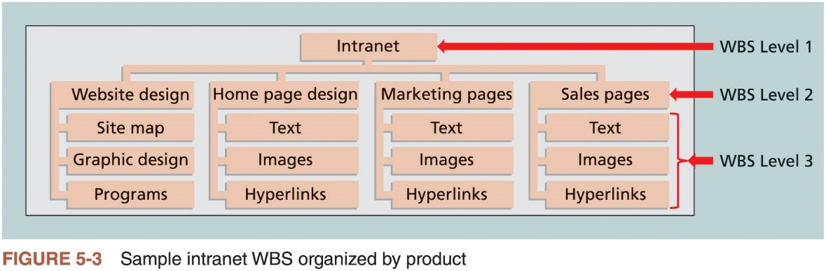
Creating the Work Breakdown Structure (2 of 9)

Slide 19
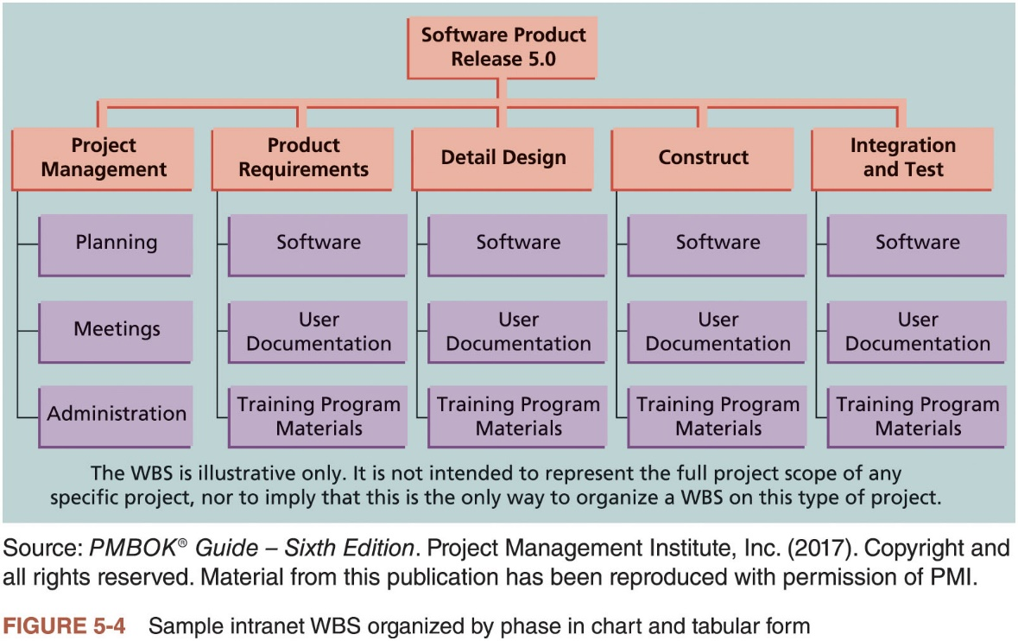
Creating the Work Breakdown Structure (3 of 9)

Slide 20
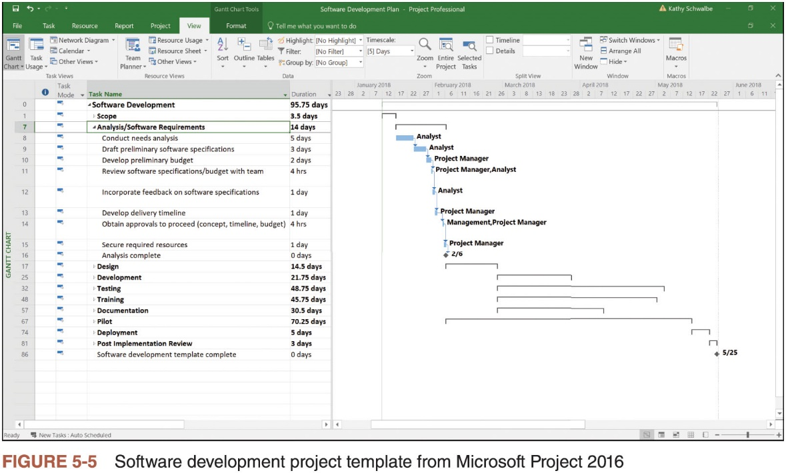
Creating the Work Breakdown Structure (4 of 9)

Slide 21
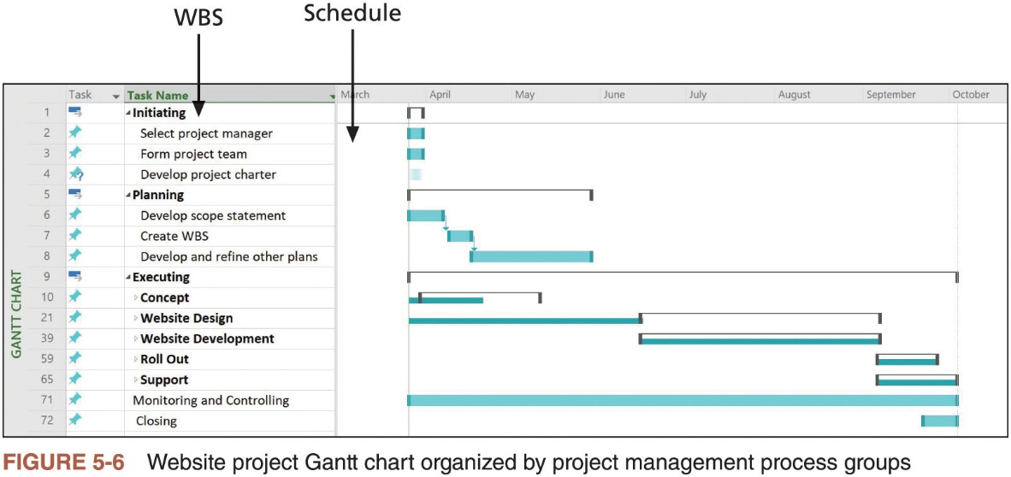
Creating the Work Breakdown Structure (5 of 9)

Slide 22
Creating the Work Breakdown Structure (6 of 9)
1.0 Software Product Release 5.0
 | 1.1 Project Management
 |  | 1.1.1 Planning
 |  | 1.1.2 Meetings
 |  | 1.1.3 Administration
 | 1.2 Product Requirements
 |  | 1.2.1 Software
 |  | 1.2.2 User Documentation
 |  | 1.2.3 Training Program Materials
 | 1.3 Detail Design
 |  | 1.3.1 Software
 |  | 1.3.2 User Documentation
 |  | 1.3.2 User Documentation
 | 1.4 Construct
 |  | 1.4.1 Software
 |  | 1.4.2 User Documentation
 |  | 1.4.3 Training Program Materials
 | 1.5 Integration and Test
 |  | 1.5.1 Software
 |  | 1.5.2 User Documentation
 |  | 1.5.3 Training Program Materials
Table 5-4 Tabular form of WBS

Slide 23
Creating the Work Breakdown Structure (7 of 9)
Approaches to developing work breakdown structures
Using guidelines: some organizations, like the U.S. Department of Defense (DOD), provide guidelines for preparing WBSs
Analogy approach: review WBSs of similar projects and tailor to your project
Top-down approach: start with the largest items of the project and break them down
Bottom-up approach: start with the specific tasks
Mind mapping: uses branches radiating out from a core idea to structure thoughts and ideas

Slide 24
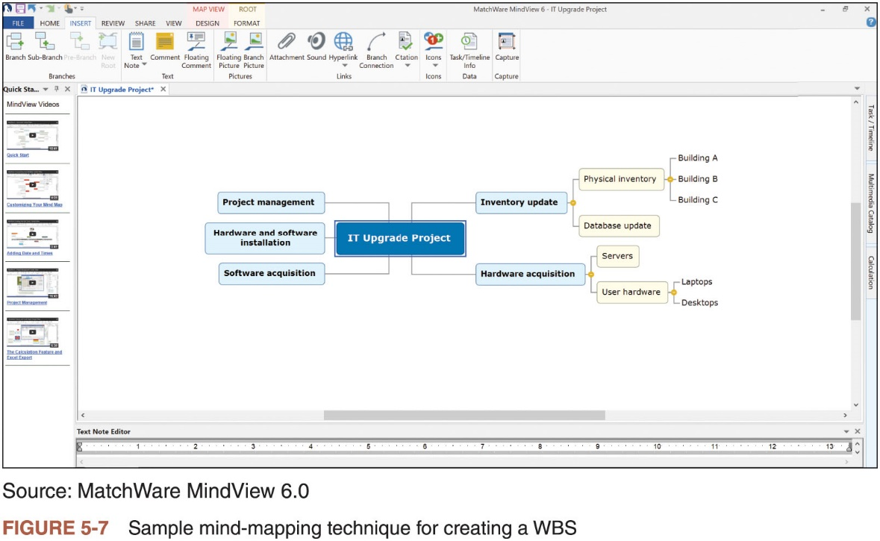
Creating the Work Breakdown Structure (8 of 9)

Slide 25
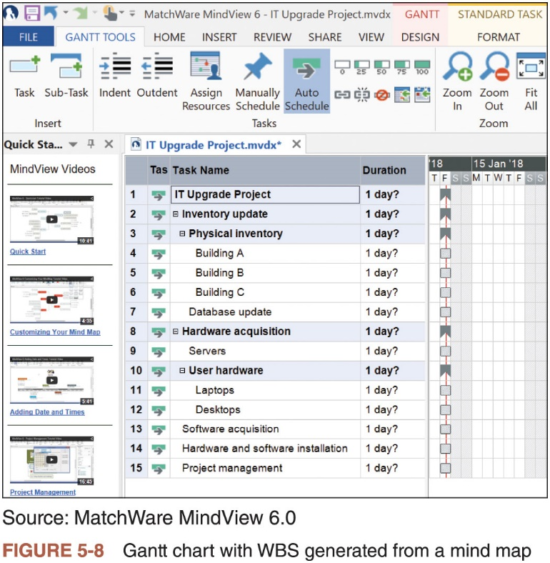
Creating the Work Breakdown Structure (9 of 9)

Slide 26
The WBS Dictionary (1 of 3)
Many WBS tasks are vague
WBS dictionary is a document that describes detailed information about each WBS item
Format of the WBS dictionary can vary based on project needs

Slide 27
The WBS Dictionary (2 of 3)
WBS Dictionary Entry March 20
Project Title: Information Technology (IT) Upgrade Project
WBS Item Number: 2.2
WBS Item Name: Database Update
Description: The IT department maintains an online database of hardware and software on the corporate intranet. We need to make sure that we know exactly what hardware and software employees are currently using and if they have any unique needs before we decide what to order for the upgrade. This task will involve reviewing information from the current database, producing reports that list each department’s employees and location, and updating the data after performing the physical inventory and receiving inputs from department managers. Our project sponsor will send a notice to all department managers to communicate the importance of this project and this particular task. In addition to general hardware and software upgrades, the project sponsors will ask the department managers to provide information for any unique requirements they might have that could affect the upgrades. This task also includes updating the inventory data for network hardware and software. After updating the inventory database, we will send an e-mail to each department manager to verify the information and make changes online as needed. Department managers will be responsible for ensuring that their people are available and cooperative during the physical inventory. Completing this task is dependent on WBS Item Number 2.1, Physical Inventory, and must precede WBS Item Number 3.0, Hardware and Software Acquisition.
Table 5-5 Sample WBS dictionary entry

Slide 28
The WBS Dictionary (3 of 3)
Advice for creating a WBS and WBS dictionary
Unit of work should appear at only one place in the WBS
Work content of a WBS item is the sum of the WBS items below it
WBS item is the responsibility of only one individual, even though many people may be working on it
WBS must be consistent with the way in which work is actually going to be performed; it should serve the project team first, and other purposes only if practical
Project team members should be involved in developing the WBS to ensure consistency and buy-in
Each WBS item must be documented in a WBS dictionary to ensure accurate understanding of the scope of work included and not included
WBS must be a flexible tool to accommodate inevitable changes while properly maintaining control of the work content in the project according to the scope statement

Slide 29
Validating Scope
It is difficult to create a good project scope statement and WBS for a project
Even more difficult, especially on IT projects, to verify the project scope and minimize scope changes
Even when the project scope is fairly well defined, many IT projects suffer from scope creep
Tendency for project scope to keep getting bigger and bigger
Scope validation involves formal acceptance of the completed project deliverables
Acceptance is often achieved by a customer inspection and then sign-off on key deliverables

Slide 30
Global Issues
Many countries have had difficulties controlling the scope of large projects
Especially those that involve advanced technologies and many different users
For example, the state government of Victoria, Australia, has a website for its public transportation smart card; there were many problems in developing and implementing the smart card

Slide 31
Controlling Scope (1 of 3)
Scope control involves controlling changes to the project scope
Keeping project goals and business strategy in mind
Goals of scope control
Influence the factors that cause scope changes
Ensure changes are processed according to procedures developed as part of integrated change control
Manage changes when they occur
Variance is the difference between planned and actual performance

Slide 32
Controlling Scope (2 of 3)
Suggestions for improving user input
Develop a good project selection process and insist that sponsors are from the user organization
Place users on the project team
Conduct regular meetings with defined agendas
Deliver something to users and sponsors on a regular basis
Do not promise to deliver what the team cannot deliver in a particular time frame
Locate users with the developers

Slide 33
Controlling Scope (3 of 3)
Suggestions for reducing incomplete and changing requirements
Develop and follow a requirements management process
Employ techniques such as prototyping, use case modeling, to get more user involvement
Put requirements in writing and keep them current
Create a requirements management database for documenting and controlling requirements
Provide adequate testing and conduct it throughout the project life cycle
Review changes from a systems perspective
Emphasize completion dates to help focus on what’s most important
Allocate resources specifically for handling change requests

Slide 34
Using Software to Assist in Project Scope Management
Word-processing software helps create several scope-related documents
Spreadsheets or presentation software to develop various charts, graphs, and matrixes related to scope management
Mind-mapping software can be useful in developing a WBS
Communication software like e-mail and web-based applications can transmit project scope management information
Project management software helps in creating a WBS; basis for creating a Gantt chart
Specialized software is available to assist in project scope management

Slide 35
Considerations for Agile/Adaptive Environments
Stakeholders define and approve the detailed scope before the start of an iteration with an adaptive or agile product life cycle, producing a usable product at the end of each iteration
Detailed scope develops over time
Agile approach provides several usable products during the project

Slide 36
Chapter Summary
Project scope management includes the processes required to ensure that the project addresses all the work required, and only the work required, to complete the project successfully
Main processes
Define scope management
Collect requirements
Define scope
Create WBS
Validate scope
Control scope

